Slide 1
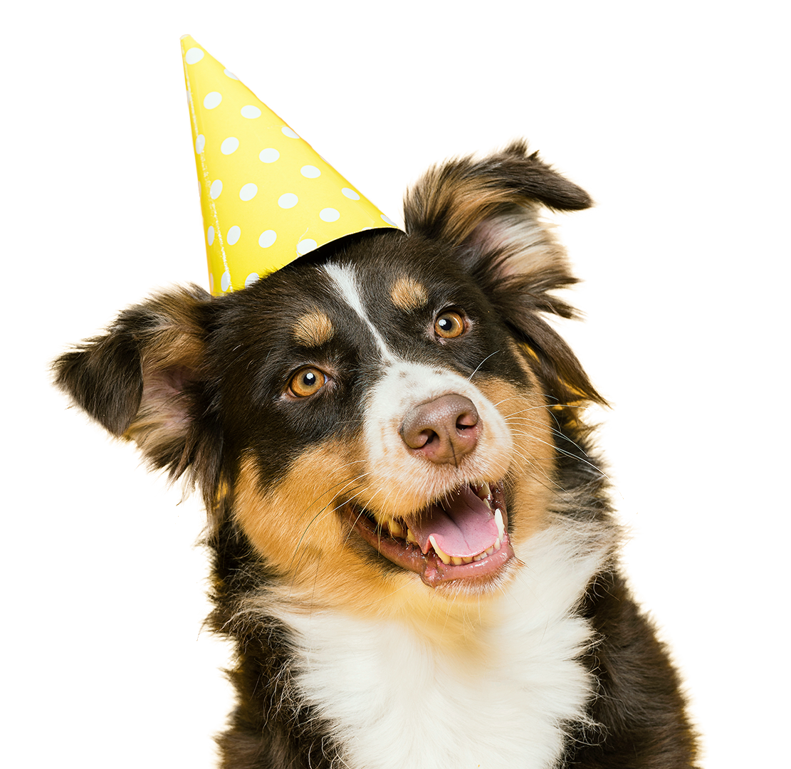
Assignment 11 SHAP
Ian Huang

Slide 2
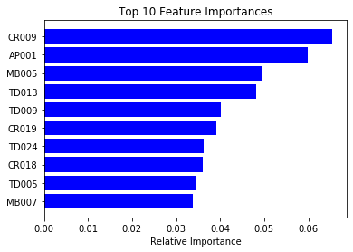
Feature Importances
The top 10 feature importances highlight the most influential variables in the model, guiding understanding and decision-making. These features have the strongest predictive power, with higher importance indicating greater influence on the model's output.

Slide 3
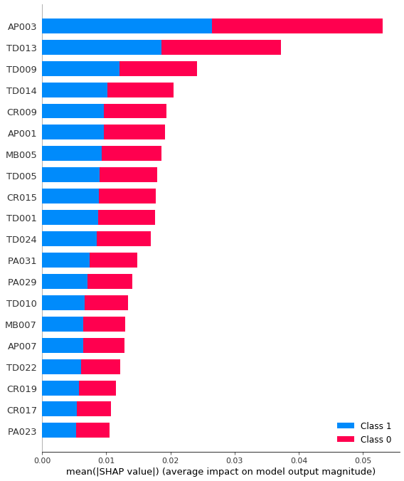
Summary Plot
The SHAP summary plot provides a comprehensive overview of the impact of different features on a model's predictions. It illustrates the distribution of the SHAP values for each feature across all the instances. Higher SHAP values signify a greater impact on the output. Features are ranked by importance, with the most influential at the top.

Slide 4
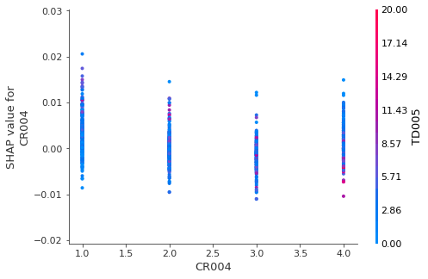
Dependence Plot
By plotting the SHAP values of a chosen feature against its values for all instances, it reveals the relationship between that feature and the model's output. The plot can uncover non-linear dependencies, interactions with other features, and more.

Slide 5
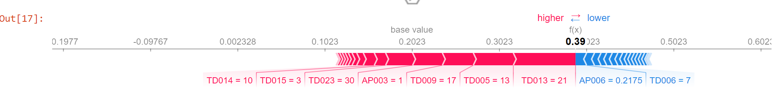
Force Plot
The force plot is a key visualization in SHAP (Shapley Additive Explanations) that helps interpret individual predictions made by a model. It displays how each feature's value contributes to pushing the model's output from the base value (average prediction) to the actual prediction for a specific instance.

Slide 6
Puppy
Your puppy’s love for you can turn your worst day into a happy day

Slide 7
Contents of This Template
Here’s what you’ll find in this Slidesgo template:
A slide structure based on a multi-purpose presentation, which you can easily adapt to your needs. For more info on how to edit the template, please visit Slidesgo School or read our FAQs.
An assortment of pictures that are suitable for use in the presentation can be found in the alternative resources slide.
A thanks slide, which you must keep so that proper credits for our design are given.
A resources slide, where you’ll find links to all the elements used in the template.
Instructions for use.
Final slides with:
The fonts and colors used in the template.
More infographic resources, whose size and color can be edited.
Sets of customizable icons of the following themes: general, business, avatar, creative process, education, help & support, medical, nature, performing arts, SEO & marketing, and teamwork.
You can delete this slide when you’re done editing the presentation.

Slide 8
Table of Contents
The Dogs
Training
Games
Advices
How much do you love your pet?
Teach your friend new tricks
Play and have fun together
Some tips on good pet care

Slide 9
—M.K. Clinton
“The world would be a nicer place if everyone had the ability to love as unconditionally as a dog.”

Slide 10
33%
of the world’s households have pet dogs

Slide 11
Highest Amount of Pet Dogs
Argentina, Mexico and Brazil are the countries with the highest amount of pet dogs per house

Slide 12
Two Realities
Adoptions
Abandonment
During this period of lockdown, the amount of dog adoptions has greatly increased
Unfortunately, there are also abandoned dogs due to owners not being able to take care of them

Slide 13
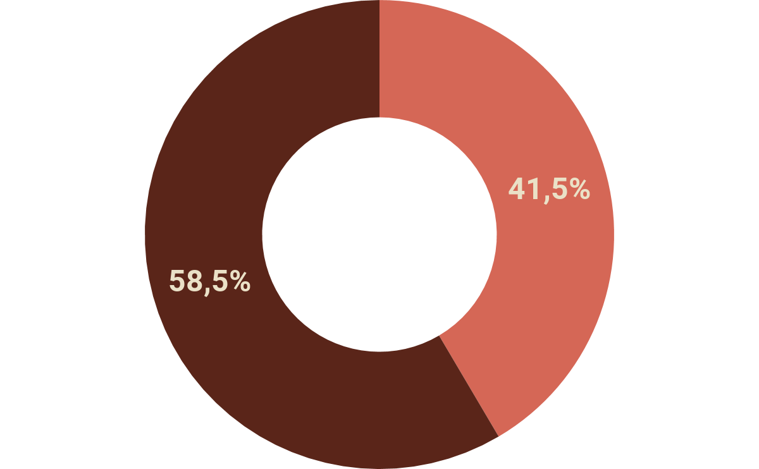
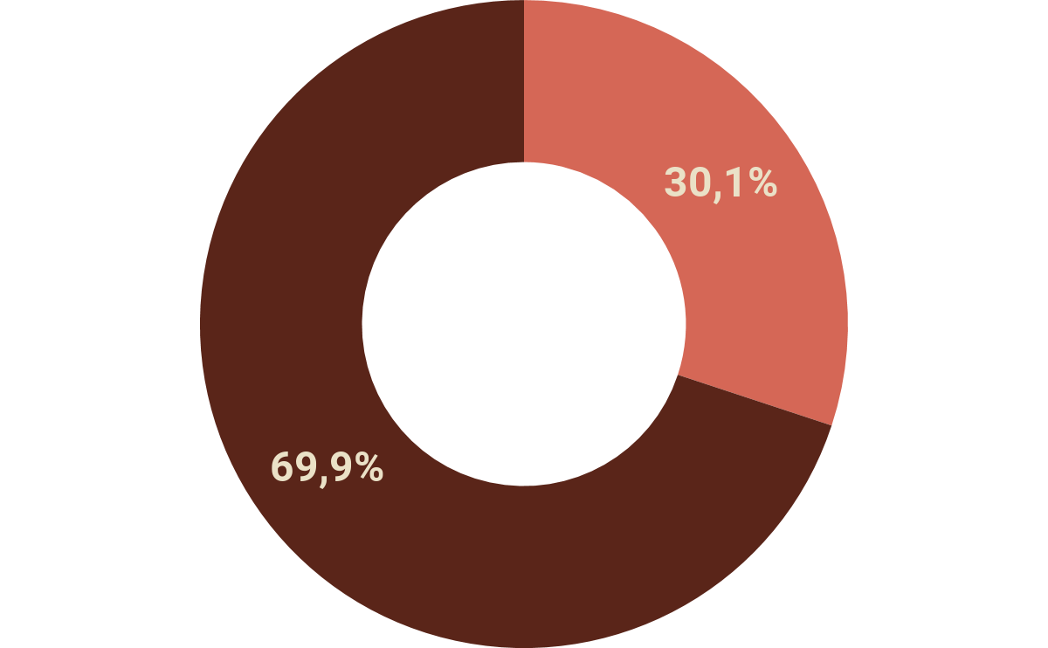
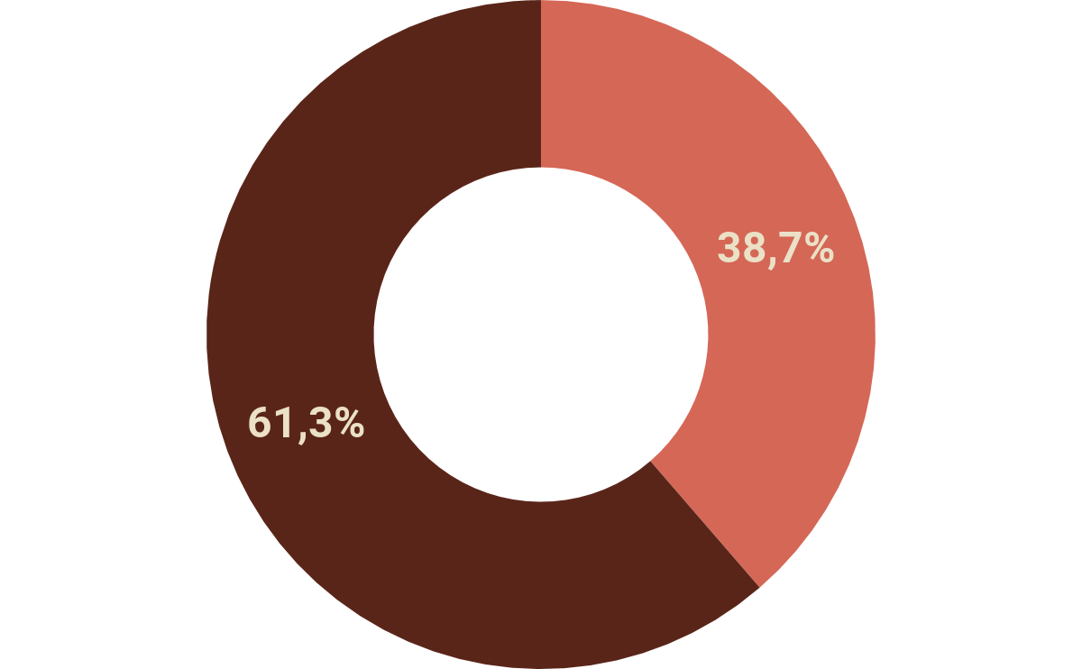
Dogs and the Lockdown
Stress
Lower Defenses
Misbehavior
Your dog most likely won’t understand why it must stay at home for so long. Vets recommend playing with them so they can spend some energy. Otherwise, they could suffer from:

Slide 14
500M
30min
3 times
dogs in the entire world
is the average duration of a walk
A day, take your dog for a walk

Slide 15

My Heart Is Full of Footprints

Slide 16
Basic Training...
1
2
3
Clicker
Name
Food
You can teach your dog that the sound of a clicker means a reward
Reward your dog whenever it answers to your calling
Make your dog follow the food when placing it in front of its nose

Slide 17
… For Your Dog
4
5
6
Call
Patience
Sit
Try to use words such as “come” and reward your dog if it obeys
Put a snack close to its nose and see if the dog tries to get the treat
Walk beside a snack and give it to your dog if it sits down

Slide 18
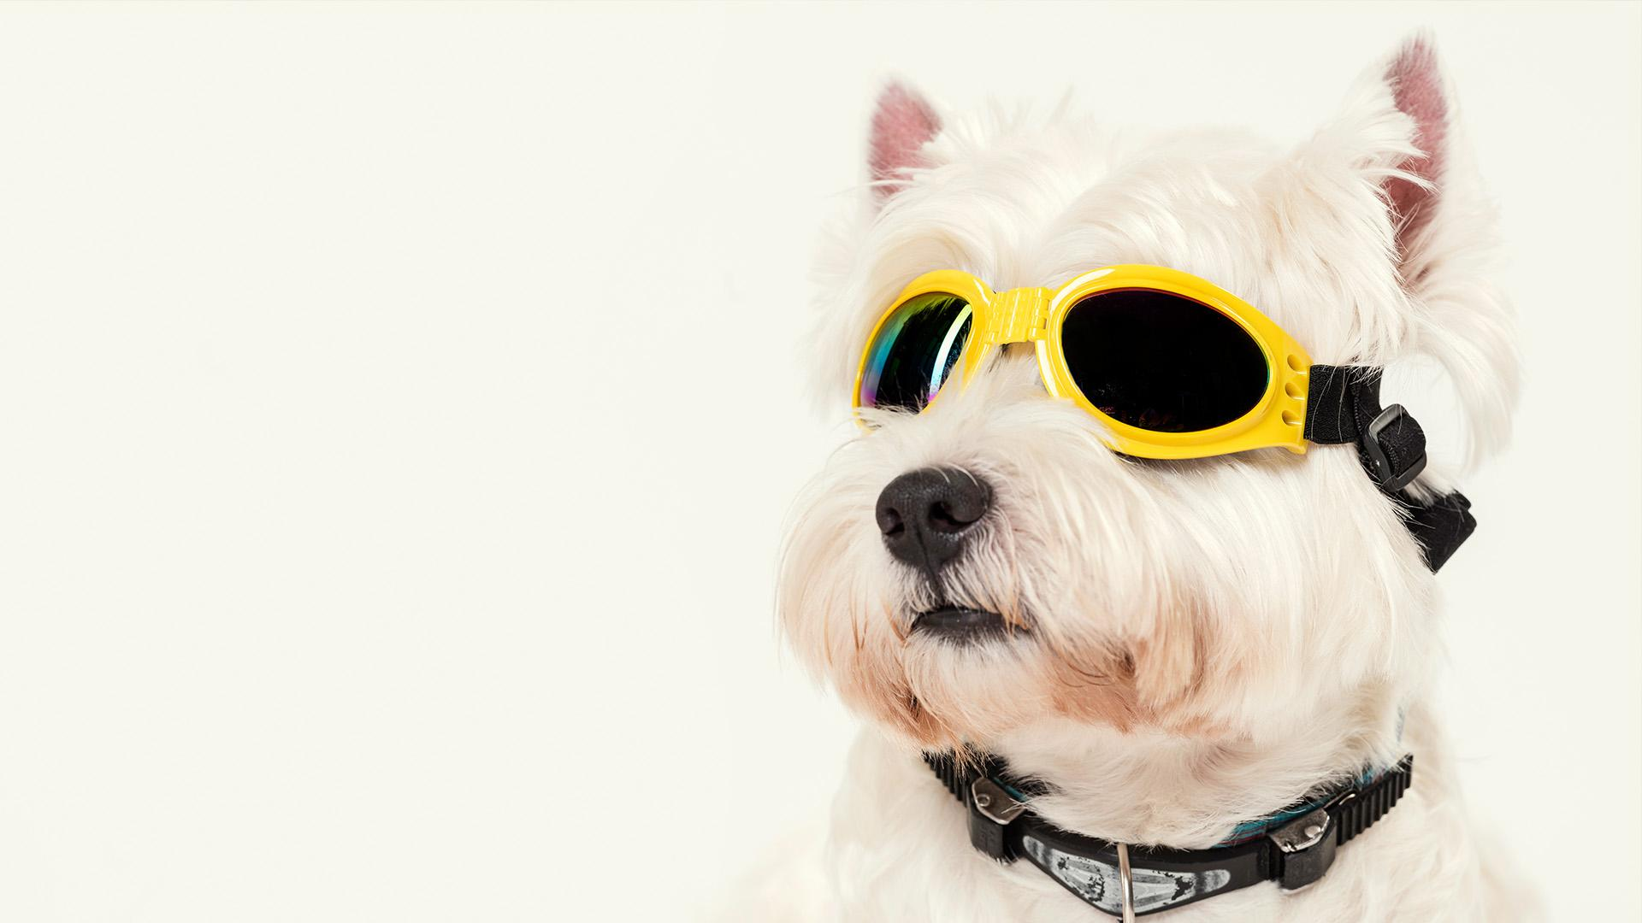
Games
Some entertaining games:
sniffing, gnawing, thinking

Slide 19
Classic Games
Catch!
Fetch!
Water!
Throw a ball and let your dog catch it!
Toss an object and let your dog fetch it
Some dogs love water and being bathed

Slide 20
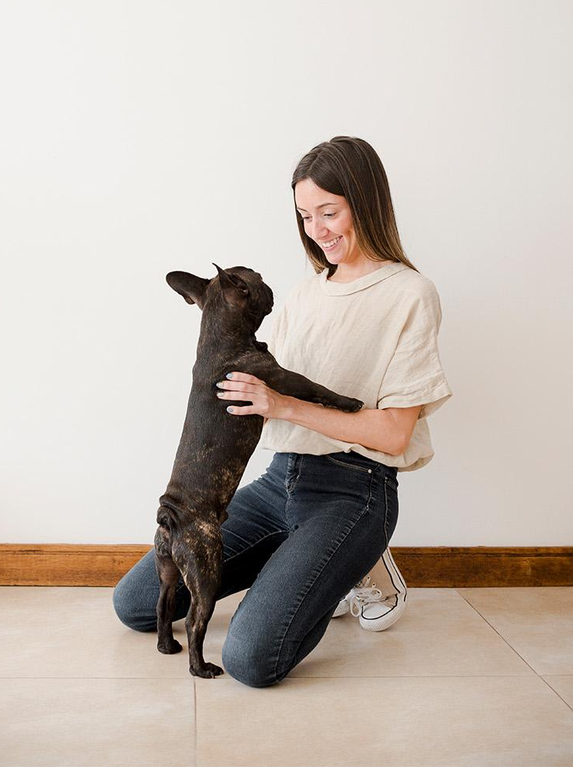
2. Hide-and-Seek
Play hide-and-seek with your dog to strengthen your emotional bonds:
Someone else keeps the dog distracted
Hide in a room or corner
The person with the dog says ‘come on, go find (your name)!’
Your dog tries to find you
Be sure to make it a big deal and reward your dog with a treat or pet it
You can change the game difficulty if your dog gets used to the game

Slide 21
3. Find It!
Part 1
Part 2
Part 3
Classic
Heights
In the Dark
Show your dog a piece of food or a treat
Hide it somewhere and say ‘find it!’
Show the piece of food or treat
Hide it at a different level and say ‘find it!’
Show the piece of food or treat
Hide it somewhere, turn the lights off and say ‘find it!’

Slide 22
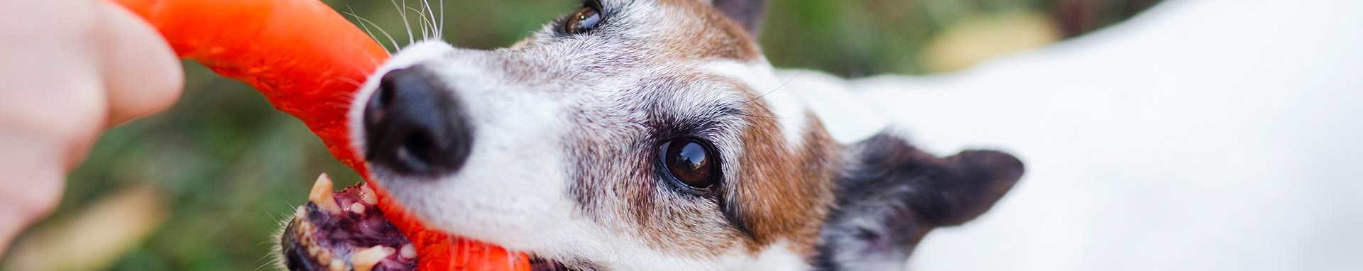
4. Tug-of-War
1
2
3
4
Grab a towel and tie some knots
Show the new towel-toy to your dog
Hold it firmly when your dog bites it
Keep playing until your dog gets tired

Slide 23
5. Agility Course
Obstacle courses for dogs are great for them. It’s good physical and mental exercise for your dog, and it keeps them entertained. You can also use them to teach your dog how to react to words such as “jump”, “roll” or “stop”. There are agility-course kits for sale at pet shops, but it’s more fun if you make your own course at home with:
Stool (to jump over it)
Chairs (to jump over them or pass underneath them)
Open cardboard boxes (to be used as tunnels)
Stick (to jump over it)
Maze with cardboard boxes (for small dogs)
Board (to cross between chairs)
Ramp (to go up)
Ball (to push it)
Hula-hoop (to go through it)
Don’t forget to give some treats to your dog!

Slide 24
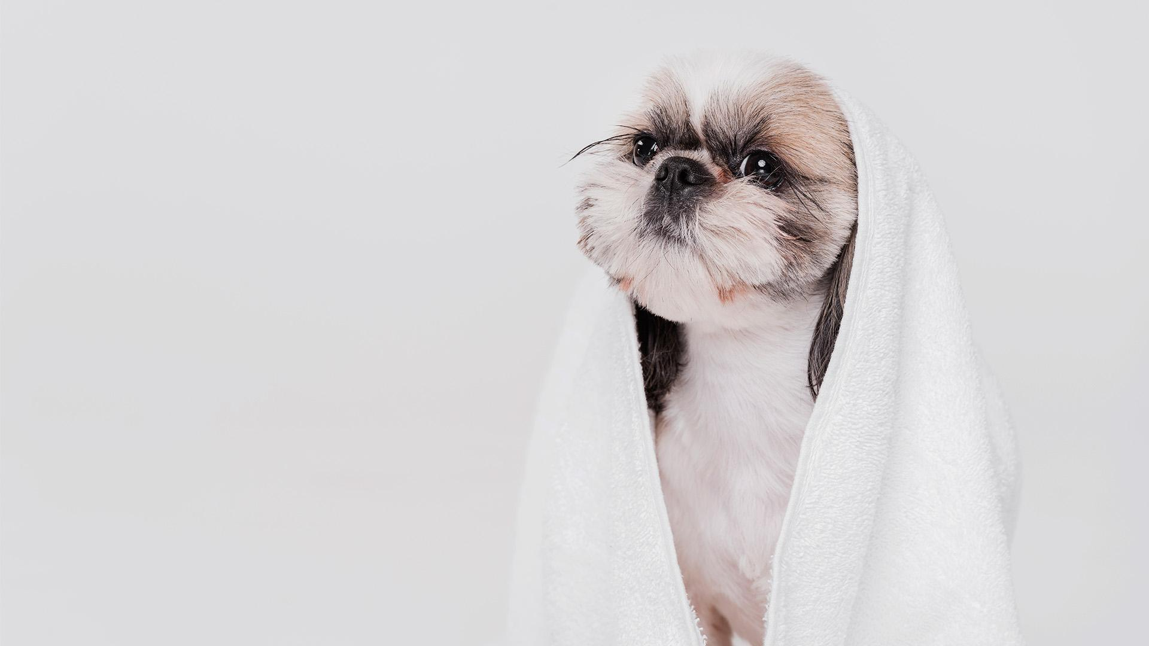
6. Relax Time
Music therapy
The blanket
Doga
Using music as a mental stimulation to reduce stress levels
Place a blanket on the floor and pet your dog when it steps on it
Practicing yoga with your dog to strengthen emotional bonds and improve its mood

Slide 25

7. Multimedia
You can watch a movie together (especially if dogs are featured on it), listen to a relaxing playlist (to calm your dog down) or a lively one

Slide 26
8. Apps
Some dogs enjoy technology too! Try downloading on your tablet some game apps for dogs and see how your dog has fun catching bugs

Slide 27
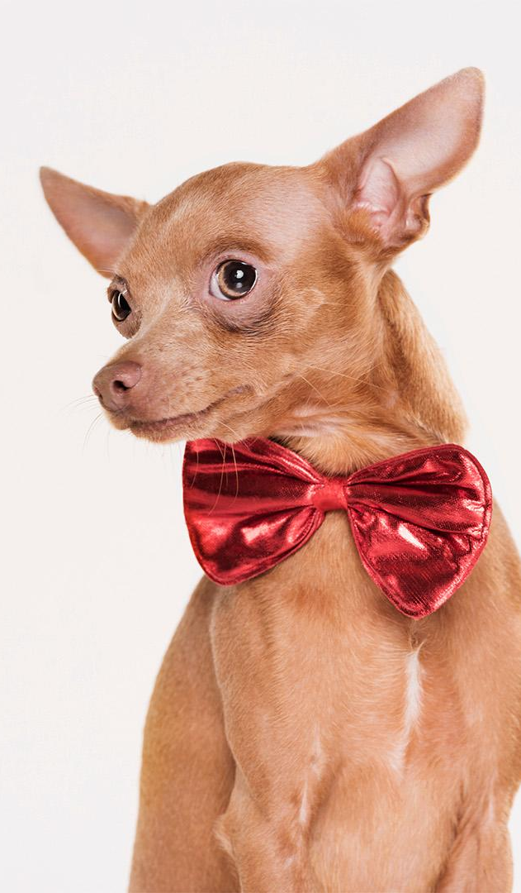
9. Dress up
To have a fun time, you can dress up your dog, take lots of pictures of you two together and share them on social media

Slide 28
Doggy Life
Happiness is a warm puppy

Slide 29
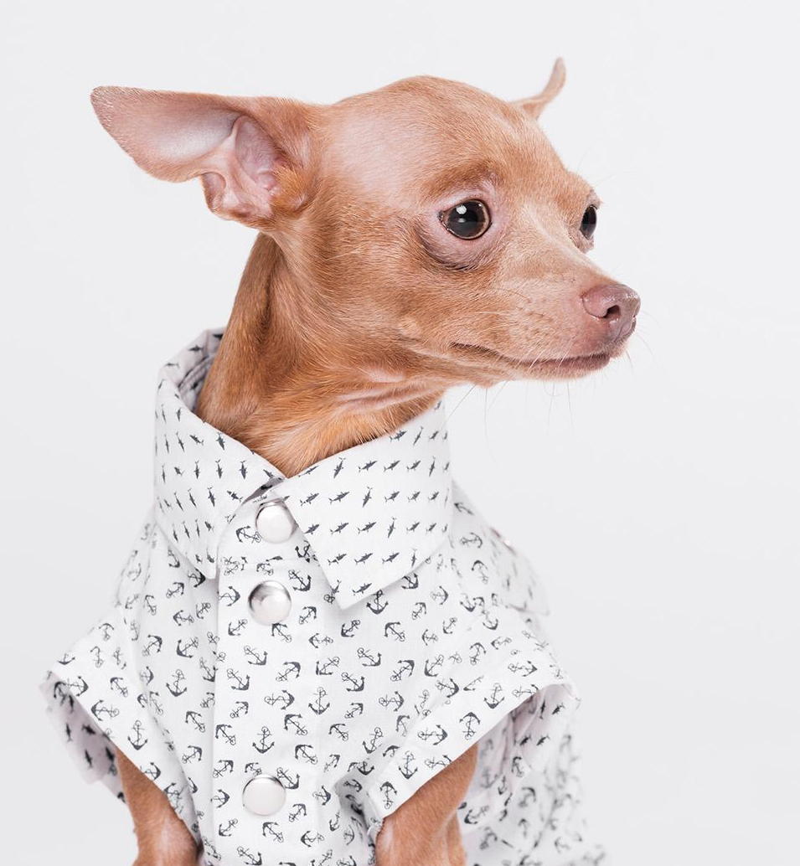
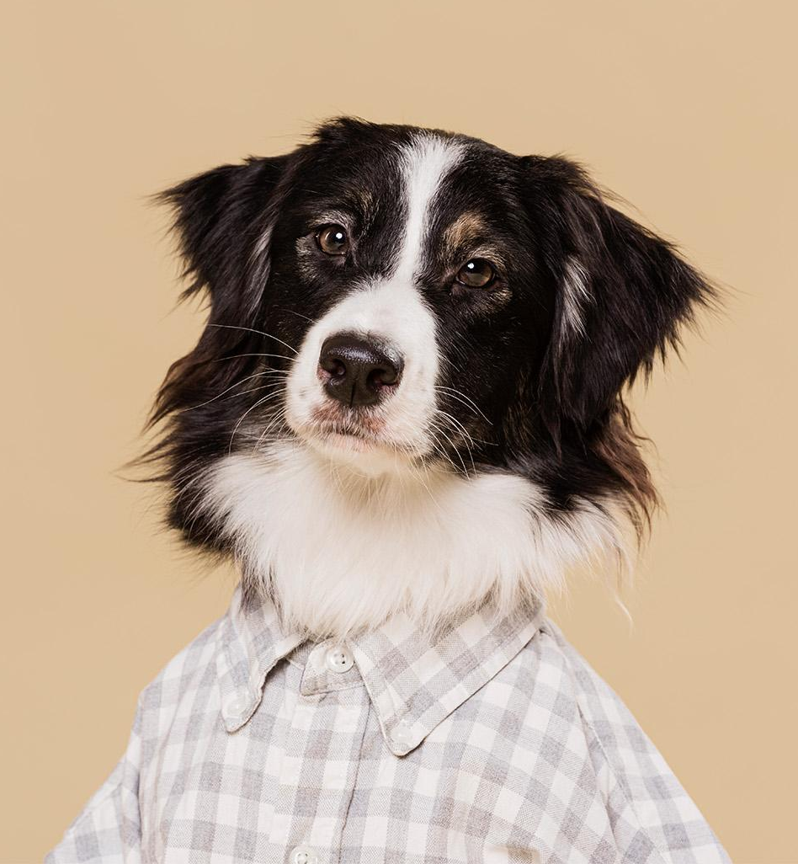
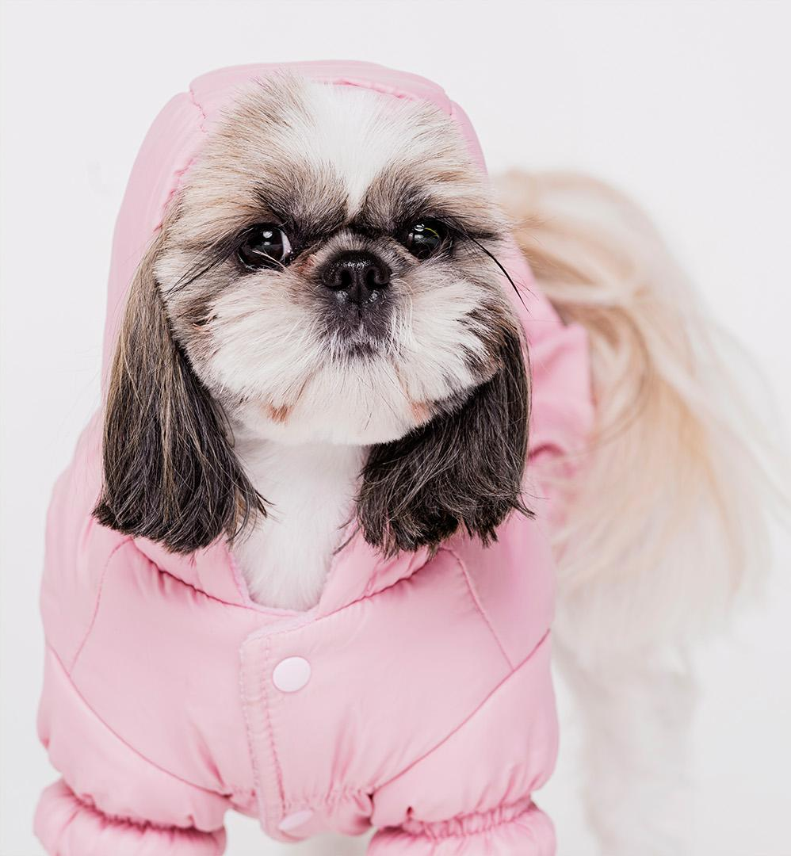
Our Little Team
Aldo
Loqui
Ariel
Has a lot of energy and is a little mischievous
The most loyal and also the shaggiest
Loves to play and is a bit conceited

Slide 30
Some Advice
Training
Games
Relax
Diet
Space
Walk
Teach your dog new tricks and skills
Try different activities to make it stay active
Teach it to relax and keep calm
It’s important to feed your dog properly
Keep an eye on this to avoid detachment
Change your walking route from time to time

Slide 31
How Much Is It?
Food
Leash
€540
€35
Vet
Toys
€300
€85

Slide 32
Tips to Save Money
Natural snacks
Vaccine campaign
Bathe it at home
Home
toys
Shop online
Bulk shopping

Slide 33
Make the Most of Its Time
20%
30%
50%
Active
Awake
Sleeping

Slide 34
The Checklist
 | Mon | Tue | Wed | Thu | Fri | Sat | Sun
Morning walk
Evening walk
Night walk
Food
Playing
Training
Bathing

Slide 35
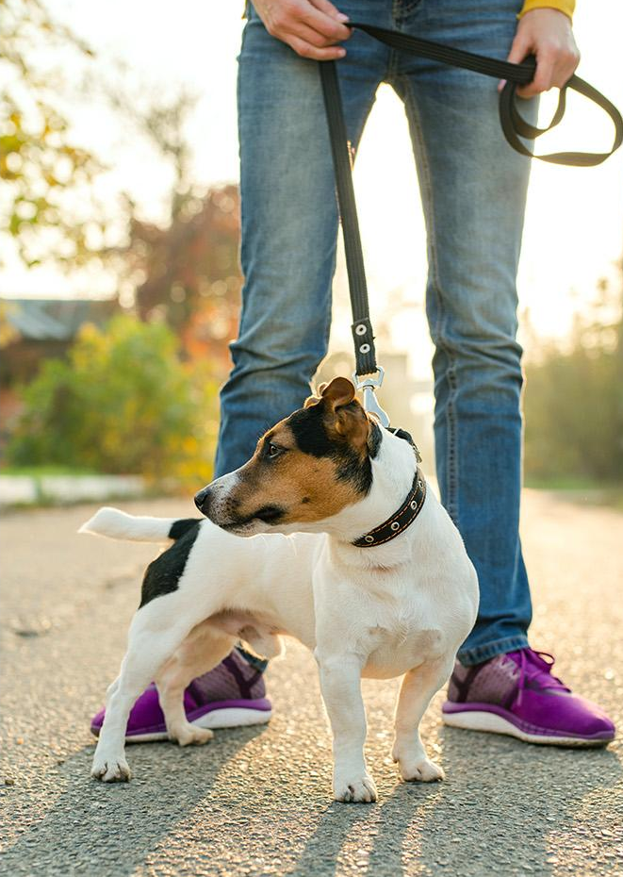
Going for a Walk during Lockdown
During the lockdown, you can walk your dog, but keep these in mind:
Walk your dog on your own
You mustn’t take more than 10 minutes
Avoid contact with other animals and people
Don’t let your dog touch banisters, doors or papers on the floor
Try different routes
Clean its paws, tail and nose after going for a walk

Slide 36
Woof!
Do you have any questions?
youremail@freepik.com
+91 620 421 838
yourcompany.com
Please keep this slide for attribution.

Slide 37
Alternative Resources
Photos
Cute dog with headphones
Cute small dog sitting
White dog playing with ball and family relaxing on sofa at background
Cute small dog with pink glasses
Young girl playing with her pup
Adorable french bulldog playing with toys
Cute dog with a towel
Cute dog with a costume
Front view cute dog sitting
Front view cute dog sitting
Cute small dog with a hat
Cute little dog with a hat
Close-up woman holding dogs paw
Vectors
Red paws background
Dog icons set

Slide 38
Resources
Did you like the resources on this template? Get them for free at our other websites
Photos
Front view cute dog with copy space
Apricot fawn pug dog with flat face and sad eyes
Loving young couple sitting with their dog on sofa against gray wallpaper
Cute small dog with glasses
Front view young girl playing with her pup
Dog playing in park with toys
Cute small dog sitting in a towel
Cute dog with a costume
Front view cute small dog
Cute little dog with a costume
Front view cute dog with shirt
Cute little dog with a costume
Close-up cute little dog out for a walk
Vectors
Cute dog background
Black dogs icons

Slide 39
Instructions for use
In order to use this template, you must credit Slidesgo by keeping the Thanks slide.
You are allowed to:
- Modify this template.
- Use it for both personal and commercial projects.
You are not allowed to:
- Sublicense, sell or rent any of Slidesgo Content (or a modified version of Slidesgo Content).
- Distribute Slidesgo Content unless it has been expressly authorized by Slidesgo.
- Include Slidesgo Content in an online or offline database or file.
- Offer Slidesgo templates (or modified versions of Slidesgo templates) for download.
- Acquire the copyright of Slidesgo Content.
For more information about editing slides, please read our FAQs or visit Slidesgo School:
https://slidesgo.com/faqs and https://slidesgo.com/slidesgo-school

Slide 40
Fonts & colors used
This presentation has been made using the following fonts:
Comfortaa
(https://fonts.google.com/specimen/Comfortaa)
Muli
(https://fonts.google.com/specimen/Muli)
#eae1c7
#d56756
#9b503f
#5a2519

Slide 41
Use our editable graphic resources...
You can easily resize these resources without losing quality. To change the color, just ungroup the resource and click on the object you want to change. Then, click on the paint bucket and select the color you want. Group the resource again when you’re done.

Slide 44
JANUARY
FEBRUARY
MARCH
APRIL
MAY
JUNE
PHASE 1
Task 1
Task 2
PHASE 2
Task 1
Task 2
JANUARY
FEBRUARY
MARCH
APRIL
PHASE 1
Task 1
Task 2

Slide 47
...and our sets of editable icons
You can resize these icons without losing quality.
You can change the stroke and fill color; just select the icon and click on the paint bucket/pen.
In Google Slides, you can also use Flaticon’s extension, allowing you to customize and add even more icons.

Slide 48
Educational Icons
Medical Icons

Slide 49
Business Icons
Teamwork Icons

Slide 50
Help & Support Icons
Avatar Icons

Slide 51
Creative Process Icons
Performing Arts Icons

Slide 52
Nature Icons

Slide 53
SEO & Marketing Icons

Slide 54


